Slide 1
Dynamic Weather Dashboard
CAPSTONE PROJECT
Presented By : J Suma
College Name & Department : East West Institute Of Technology,
Bengaluru.560091
CSE(IoT, CyS & BCT)

Slide 2
OUTLINE
Problem Statement
System Development Approach
Algorithm & Deployment
Result
Conclusion
Future Scope
References

Slide 3
Problem Statement
Weather plays a critical role in agriculture, transportation, health, and daily activities.
Sudden and unpredictable weather changes can lead to disruptions, risks, and losses.
People often face difficulties in accessing accurate, real-time weather information.
There is a need for a system that can provide weather updates in a simple and accessible way.

Slide 4
System Approach
Front-end Development
HTML for structure.
CSS for design & styling.
JavaScript for dynamic weather updates.
Data Source
Weather data fetched via an API (e.g., OpenWeatherMap API).
Integration
User enters a city/location.
API returns weather data (temperature, humidity, wind speed, conditions).
Website displays data with appropriate weather icons.
Mobile-responsive design

Slide 5
Algorithm & Deployment
Algorithm:
Fetch API request → Process JSON response → Extract key weather info → Update webpage dynamically.
Example:
Input: City Name (e.g., "Hyderabad").
API Response: {temperature: 32°C, humidity: 55%, wind: 10 km/h}.
Output: Display weather on UI with icons (sun, clouds, wind, etc.).
Deployment:
Runs in browser (client-side).
Can be deployed on platforms like GitHub Pages, Netlify, or Vercel for free hosting.

Slide 6
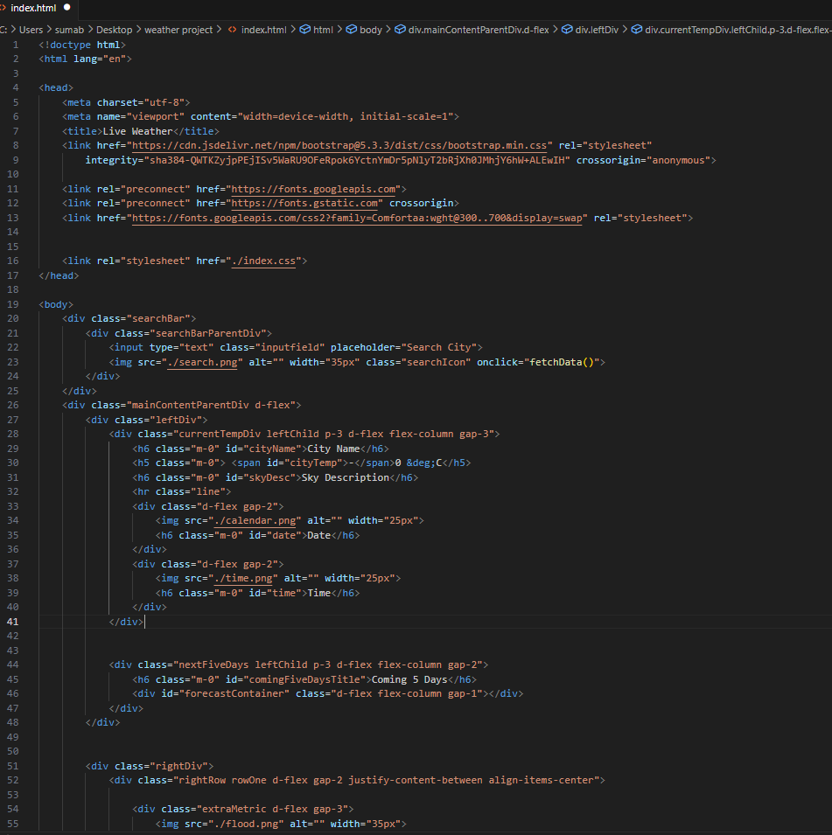
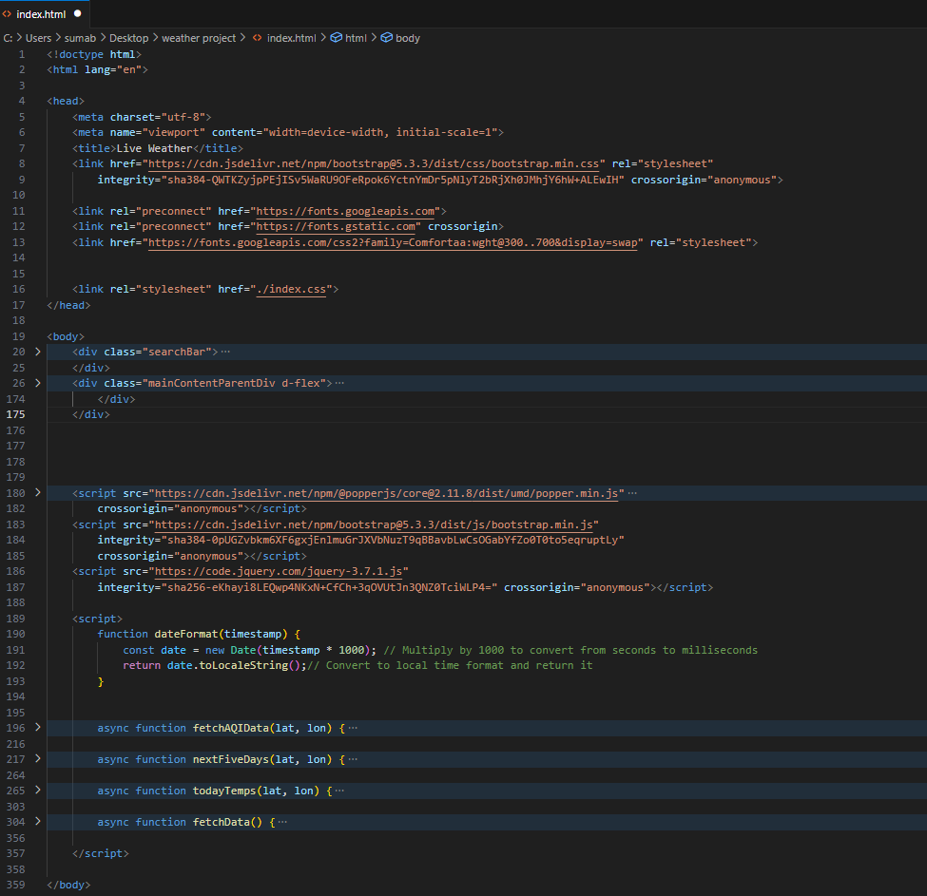
code

Slide 7
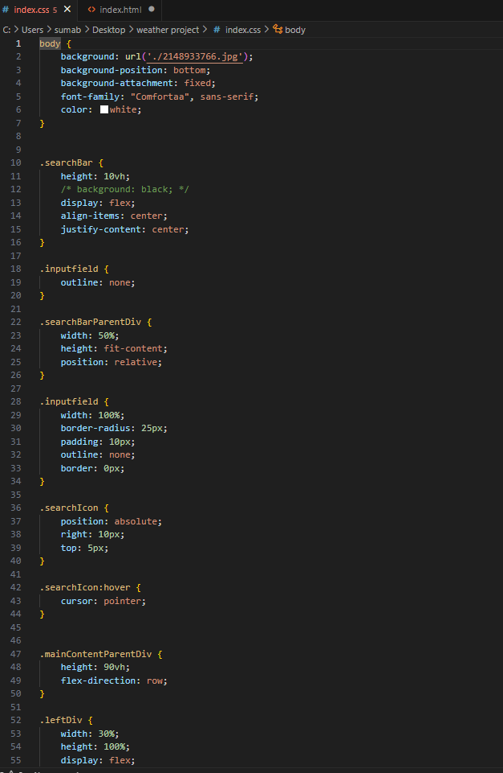
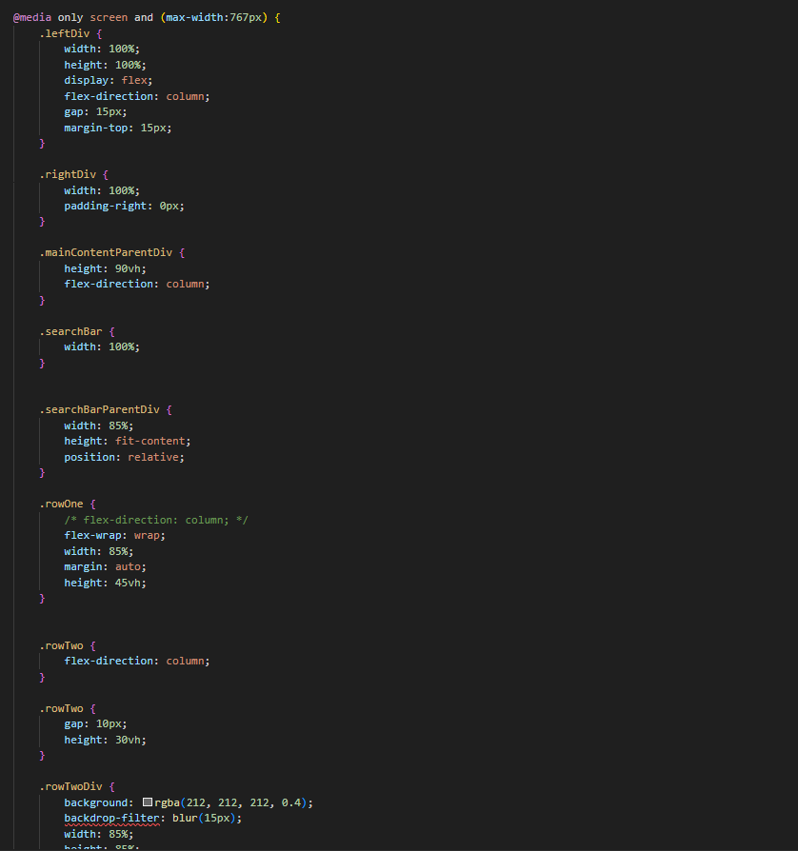
code

Slide 8
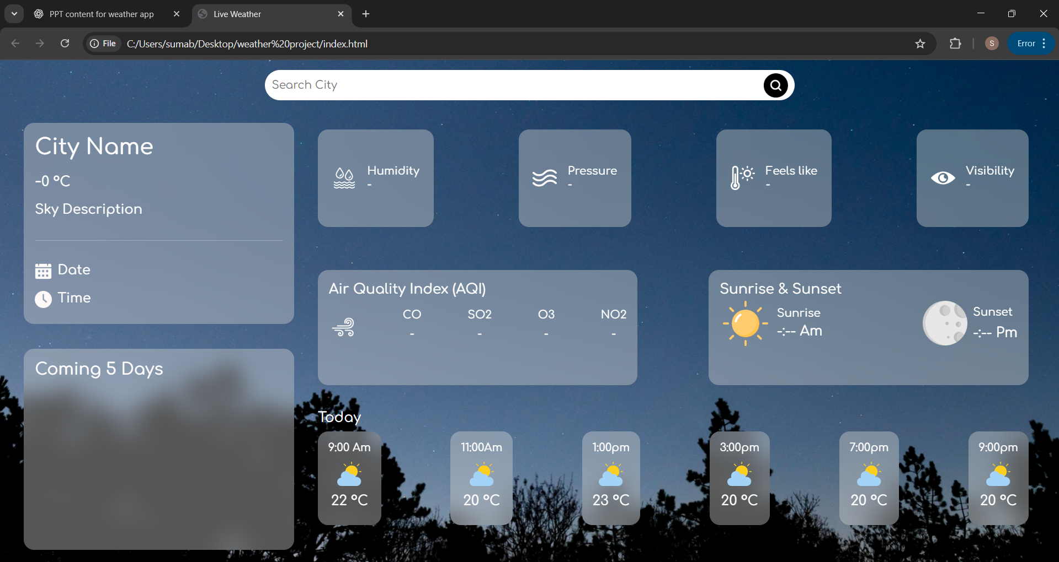
Result

Slide 9
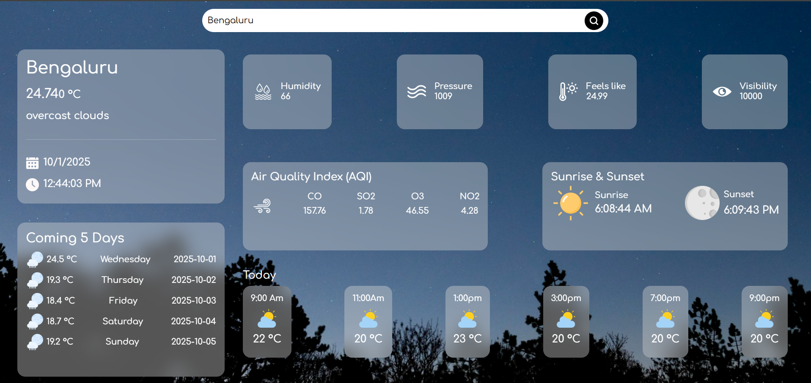
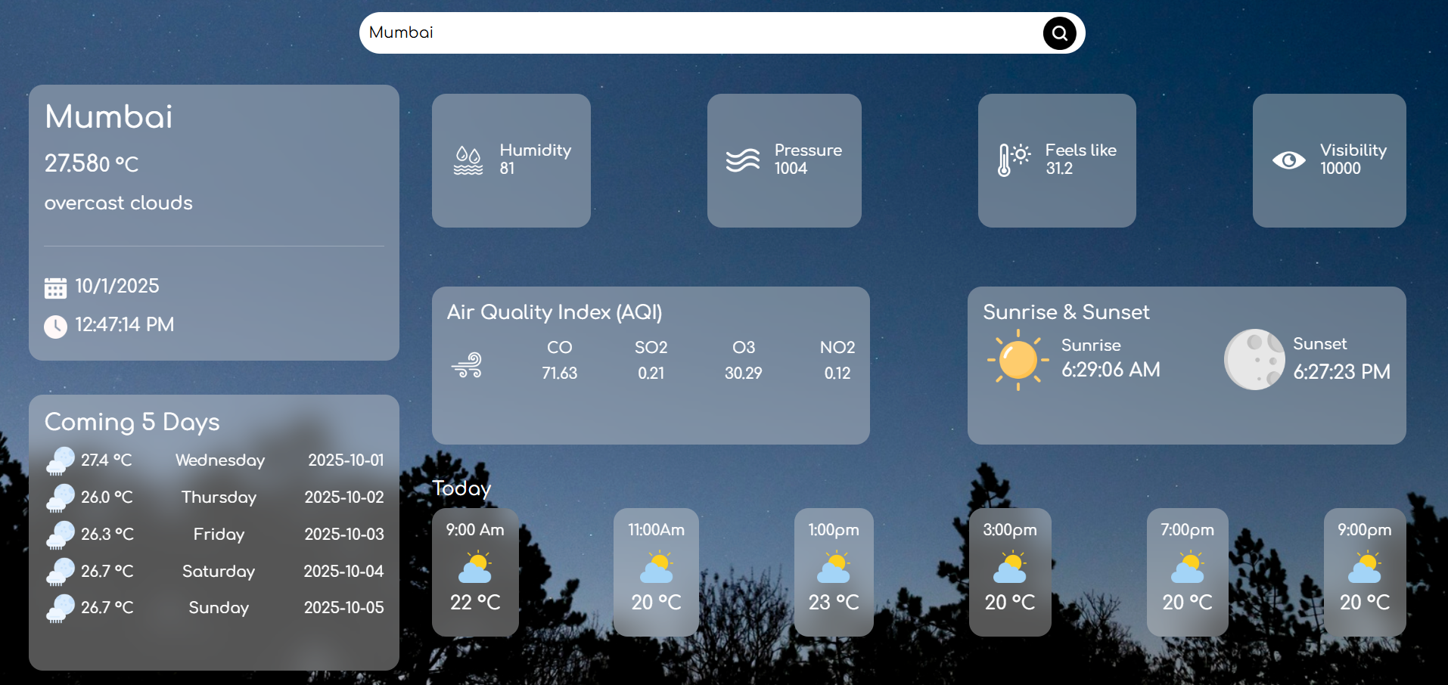
Result

Slide 10
GitHub and deployment link
GitHub Link
https://github.com/suma3100/Dynamic-Weather-Dashboard-using-OpenWeatherMap-API
Deployment Link
https://suma3100.github.io/Dynamic-Weather-Dashboard-using-OpenWeatherMap-API/

Slide 11
Conclusion
Successfully implemented a weather forecasting web app.
Provides real-time, accurate weather information in a simple interface.
Demonstrates how APIs can be integrated into web development projects.

Slide 12
Future scope(Optional)
Add 5-day or 7-day weather forecast.
Include air quality index (AQI) monitoring.
Add location auto-detection using GPS.
Build a mobile app version of the project.
Send weather alerts/notifications (e.g., rain or storm warnings).

Slide 13
References
OpenWeatherMap API – https://openweathermap.org/api
W3Schools – HTML, CSS, JavaScript Tutorials
Mozilla Developer Network (MDN) – Web Development Documentation
IEEE Paper: Weather Data Visualization and Prediction Systems (2022)
IEEE Paper: API-Driven Web Applications for Real-Time Data (2023)

Slide 14
THANK YOU

